Slide 1
Aquifer Storage Recharge David Haasnoot (4897900) & Justin van Beek (4480783)

Slide 2
Situation
40 000 [m^3] in August & July
10 < k < 40 [m/d]
0.25 < φ < 0.5 [-]
0.5 < α < 2 [m]
20 [m]
Salt = 30 [g/l]
Notes:
This sytstem and design needs to hold the following important parameters:
The drinking water company needs to extract a total of 40,000 m3 of drinking water during the summer months of July and August.
A time schedule for injection, extraction and, if necessary, storage.
The waste of injected drinking water needs to be as small as possible.
The system needs to meet the guidelines for injection pressure and maximum velocity during extraction. • The ASR system can function for at least 10 years with possibly a start-up year when the extracted volume is smaller.

Slide 3
Methodology and rules of thumb
Maximum infiltration and extraction rate, soil compaction and dispersivity

Slide 4
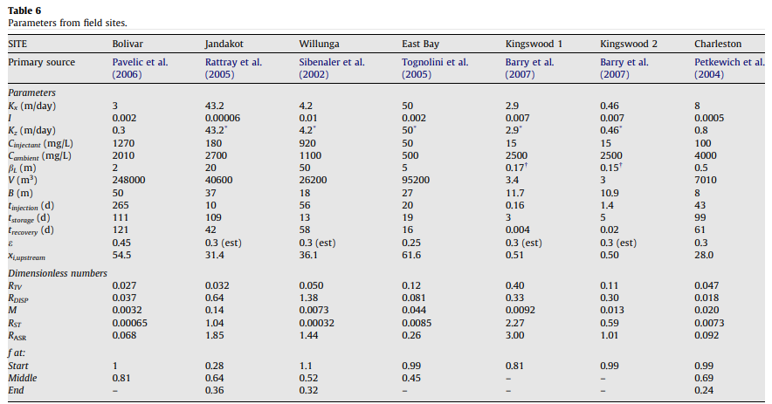
Comparable systems
Notes:
What is important to see on this figure is:
Efficient injection and recovery is achieved by aquifers with moderate to high hydraulic conductivity
A suitable hydraulic gradient will ensure effective movement of water in and out of the aquifer
The recover efficiency increases with an increasing rate between injection time and extraction rate.
The Charleston system as described in the figure has the most overlapping factors with the system discussed in this report

Slide 5
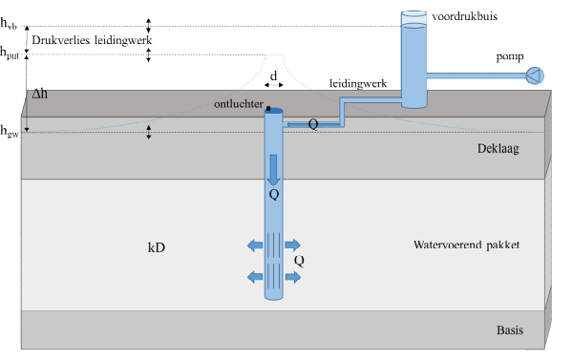

Maximum infiltration rate
(De Glee)
k = hydraulic conducitivity of aquifer (m/d)
D = thickness of aquifer (m)
c = hydraulic resistance of confining layer (d)
r_{well} = well radius (m)
h_{in} = infiltration head (m + land surface)
h₀ = natural hydraulic head in aquifer (m + land surface)
$$Q_{in}=\frac{2πkD\left(h_{in}−h_{o}\right)}{\ln\left(\frac{\sqrt{kDc}}{r_{well}}\right)}$$
h_{in}
h₀
Van Dooren et al. (2020): https://library.kwrwater.nl/publication/61802381/
Notes:
If this is too high it could cause:
Over-pressurization of the aquifer which could in the end lead to fracturing or compaction of the aquifer
Clogging of flow paths due to the damage to the internal structure of the aquifer
Changes in groundwater flow patterns could be induced which causes water to flow away from the aquifer and increase heads in surrounding areas
Other legal issues, for example the displacement of contaminants or other particles in the water to an area where those aren’t allowed

Slide 6

Particle mobilization
$qmax =\frac{\sqrt{k}}{30}$ (Huisman, empirical)
$Q_{max}=q_{max}∗2Lπr_{well}$
L = screen length (m)
r_{well} = well radius (m)
k = hydraulic conductivity (in m/s)
Van der Schans & Meerkerk (2019): https://library.kwrwater.nl/publication/60518580/
Olsthoorn (1976): https://edepot.wur.nl/403280
Notes:
Issues that could arise if the extraction rate is too high:
A specific discharge that is too high could lead to compaction of the surrounding rock or soil and this in its place leads to land subsidence.
High specific discharge may indicate that the aquifer is being pumped or exploited at a rate exceeding its natural recharge capacity. This can lead to a decline in groundwater levels, potentially causing wells to go dry and impacting the sustainability of water supply.
If the discharge is too high, it could lead to water flowing from or to the aquifer. This may lead to increased discharge into rivers, streams or lakes. Wetlands (animals and plants), ecosystems and reservoirs could be destroyed in the process.

Slide 7
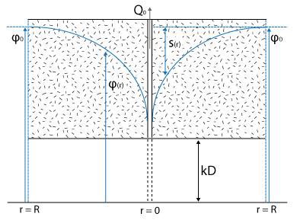

Soil compaction
Koppejan: $Z=d\left(\frac{1}{C_{p}}+\frac{log\left(t\right)}{C_{s}}\right)ln\left(\frac{φ+\frac{1}{2}dφ}{φ}\right)$
Z = soil compaction (m)
d = thickness of confining layer (m)
C_{p} = primary compaction constant (-)
C_{s} = secular compaction constant (-)
Φ = pore pressure (kN/m²)
dΦ = change of pore pressure (kN/m²)
t = time (days)
Notes:
The primary soil compaction is varying from 7 to 140
The secular soil compaction is varying from 80 to 1680
Pore pressure change of 40 (kN/m2)
The importance of the determination of the maximum soil compaction is great, because a large amount of compaction could lead to subsidence or decreasing of hydraulic conductivity. Subsidence in its place can cause mass damage to infrastructure and buildings at the surface. Decreasing of the hydraulic conductivity can lead to a decrease in the recover efficiency from the reservoir

Slide 8
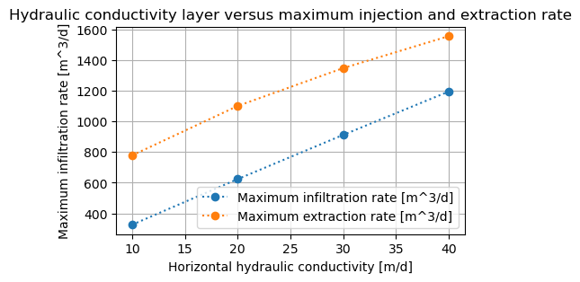
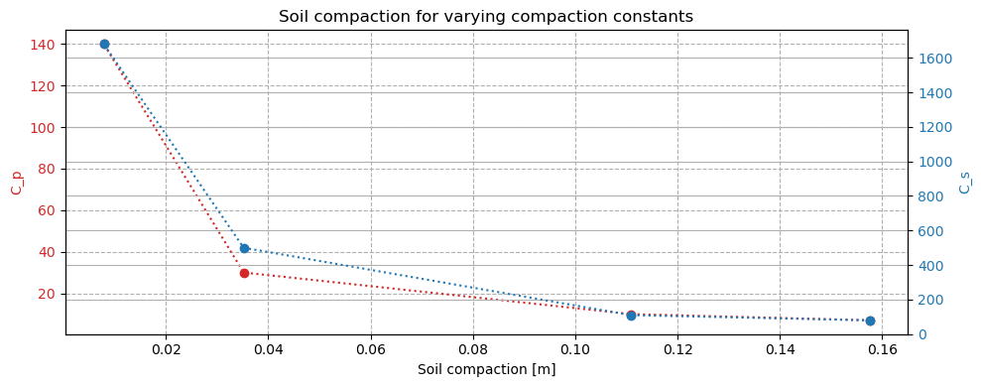
Results for analysis rules of thumb
Notes:
As can be concluded from figure on top that in the worst case (k = 10[m/d]) the maximum injection rate is 350 m3 d , but because we inject over 303 days, we suspect that the maximum injection rate doesn’t will be a constraint for this system. It is important to check as this will vary based on the efficiency of the system. The extraction rate however could become a problem for the system. The maximum extraction rate in the worst-case scenario will be 800 m3 d if this extraction rate is too low, a change can be made in the radius of the extraction well. The extraction rate won’t vary as the total of 40 000m3 in two months is a design requirement.
It is shown in the bottom figure that the soil compaction increases for a lower value of the compaction coefficients, so in the worst case (sandy aquitards) will lead to a compaction of 0.16 m which is acceptable in most cases, but not with critical buildings, maybe some soil compaction need to be in place. This calculation is based on the head change for the average change in pore pressure, this will increase even further if the hydraulic conductivity of the aquifer is lower and the change in head is higher, so that should be taken into account if more knowledge is present about the exact hydraulic conductivity, this knowledge often is available after 1 cycle.

Slide 9
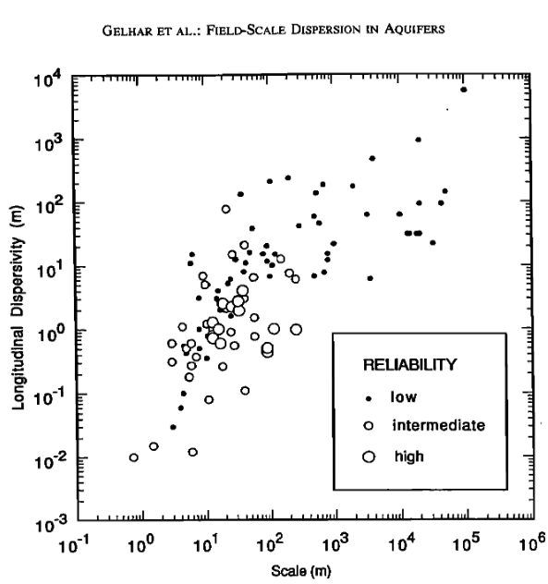
Dispersivity
0.2 < α_{L} < 95
0.5 < α_{L} < 2.0
Notes:
The dispersivity of an aquifer is a parameter that characterizes the spreading or dispersion of solutes as they move through the porous media of the aquifer
Dispersivity is determined based on this graph using the scale we are working in .

Slide 10
Design ASR system

Slide 11
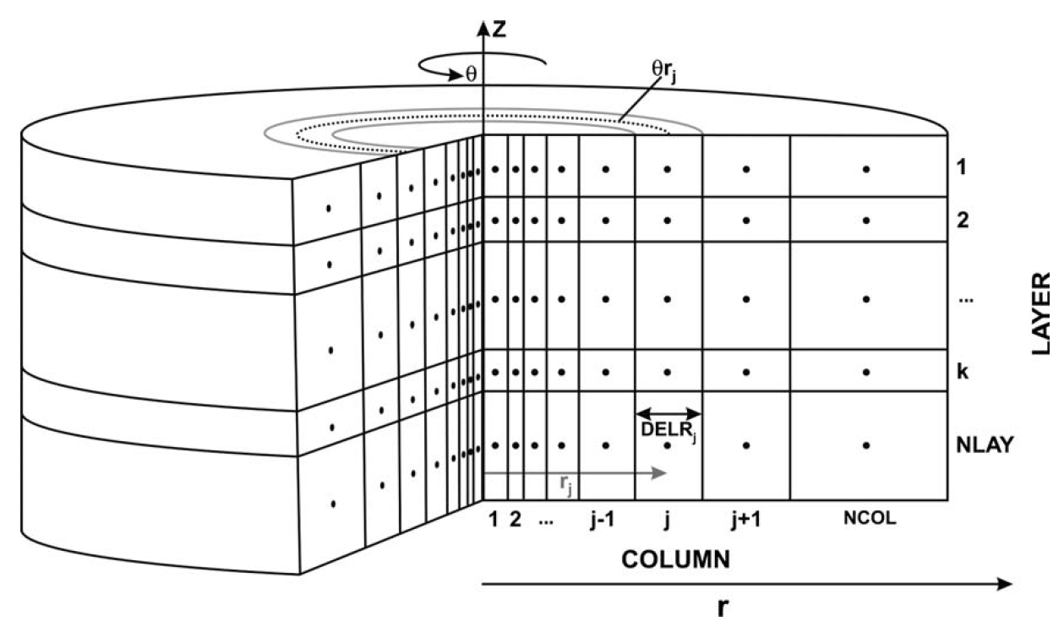
1D radial Model
Langevin,2008
Vary Hydraulic conductivity & porosity
1
2
…
Ncol
Qin
Qin
Notes:
Radial flow used to reduce modeling complexity, for our use case this gives enough insight
MODFLOW requires a constant cell size we vary hydaulic conductivity and porosity with distance from the well
To still mimic radial flow, the porosity and hydraulic conductivity change moving out from the well
Scale the porosity and hydraulic conductivity to still model the groundwater flow correctly

Slide 12
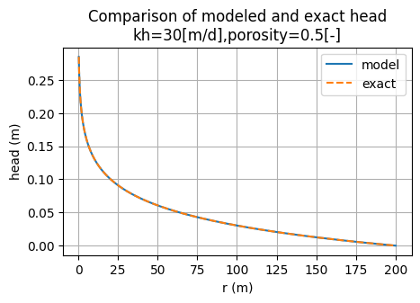

Modelled head
$$Exact: h=−\frac{Q}{2πkH}\ln\left(r/R\right)$$
Notes:
We can compare this to the analytical solution of the head
We see these are fairly similar, slight deviations do occur

Slide 13
Results

Slide 14
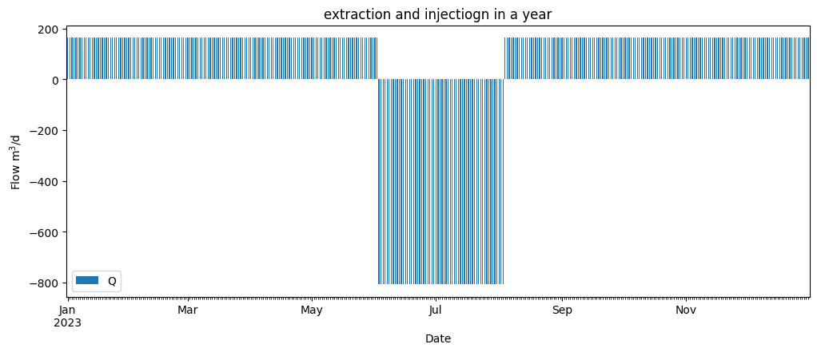
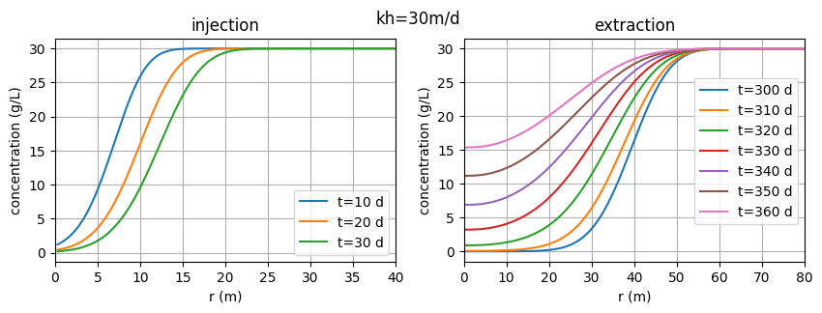
Concentration during injection & extraction
Npor = 0.35, α = 0.5
Notes:
Although heads and flows are interesting, Salt transport model is most useful.
The water is assumed to be injected throughout the year (303 days) and extracted in the 62 days during July and August.
The extraction is stopped when the concentration reaches 1g/L as this is a design limit.
In the first year this happens after 27 days of extraction (day 340) as seen depicted as the purple line in figure 3.2. This results in a low efficiency of 61%.

Slide 15
Simulation for 10 years
Notes:
This can also be repeated for 10 years.

Slide 16
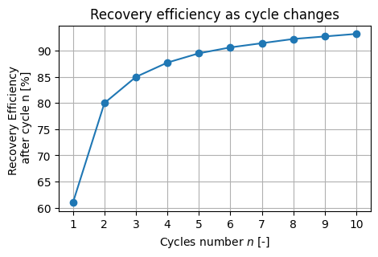
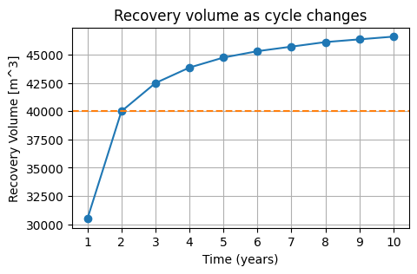
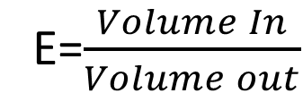
Efficiency over 10 years
E=$\frac{Volume In}{Volume out}$
Notes:
Setting the final conditions of the first year as initial conditions of the second year
Efficiency is higher, because it creates a transition area from fresh to brackish water
1.25 is set so that from the second year the design value is met
The total wanted production is 40 000 m3 /year, initially a design factor of 1.25 is applied to account for losses resulting in a total injection of 50 000 m3 /year,. For the later years where efficiency reaches around 90% this is too high, but this is adjusted later.
This results in an extraction of 806m3 /d and an injection of 165m3 /d.

Slide 17
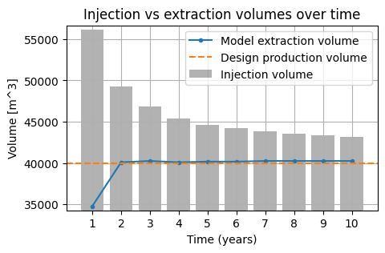
Schedule for injection, extraction and storage
Notes:
Because efficiency increases, the injection volume can reduce over time to cut down waste water
Updated manually, minimsation scheme was not used due to the time it needs to run
After 10 years effeciency almost levels off
Loss will be eminent

Slide 18
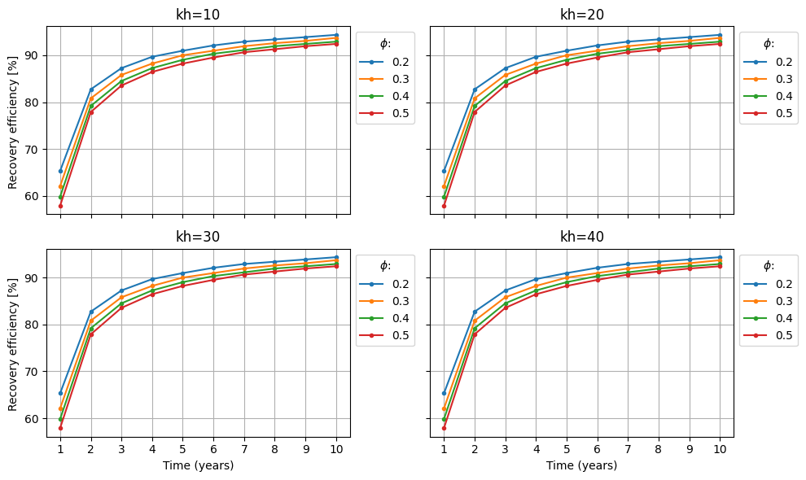
Parameter sensitivity
Hydraulic conductivity & Porosity
Notes:
Hydraulic conductivity varies from 10 to 50 m/d
Porosity can vary from 0.25 to 0.45
Simplification: constant injection volume every year is used
Higher porosity is lower efficiency – water mixes easyer with the brackish water.
Hydraulic conductivity has only effect on the response of groundwater heads

Slide 19
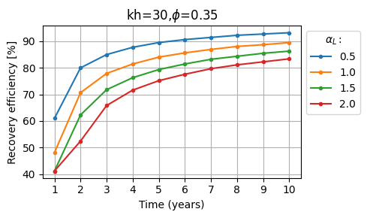
Parameter sensitivity
Dispersivity
Notes:
Dispersivity ranges from 0.5 to 2
Higher value of dispersivity is a lower effciency
Parameters keep an asymptotic profile
Some combination of parameters are shifted down, but these can likely be compensated throught the injection scheme proposed.

Slide 20
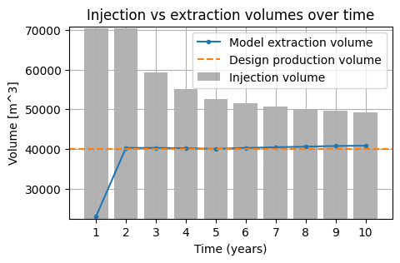
Worst case scenario
Npor = 0.35, α = 0.5
Notes:
Worst case : k = 10 m/d, porosity = 0.5 and ldc = 2
70000 m3 injection needed to meet demand within 303 days
Maximuym allowed is 350 m3/d so it is in range
To meet the extraction requirements a larger well radius should be used

Slide 21
Conclusion and take-aways
Notes:
Take - aways

Slide 22
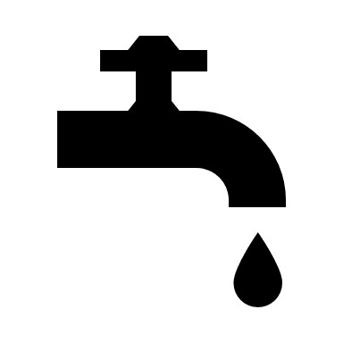

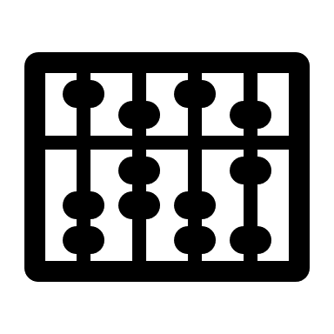



Conclusions
Take – aways
Notes:
Conclusions
Injection volume can be lowered over time and still meet demand and minimise waste water
Higher porosity leeds to lower efficiency
Higher hydraulic conductivity only affects regulations (head-difference) but not the efficiency directly
Higher dispersivity means lower efficiency
The worst case scenario still meets injection regulations, but exceeds extraction regulations so well radius needs to change
Take aways
More certainty in porosity and hydraulic conductivity is needed.
Optimization after the first cycle, considering actual system performance data.
Investigation into different well radii can be conducted to prevent failing of project while working with worst case

Slide 23
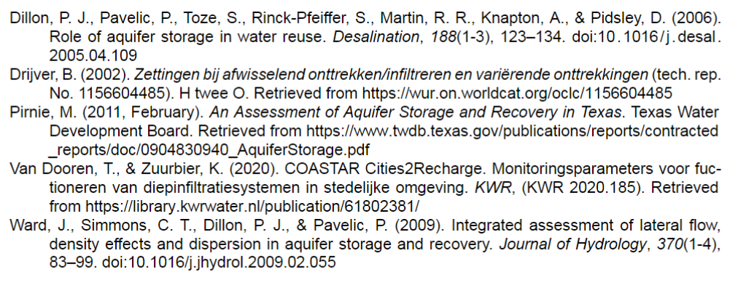
References

